Slide 1


Slide 2

Python programming Introduction Content
Data types/outputs/inputs
Operators
Functions and Modules

Slide 3
Python programming Introduction Content
Conditional statements and expression
Loops
Work with standard Library and Modules

Slide 4
Python programming Introduction Content
Data structure in python
List
Tuple
Dictionaries
Set

Slide 5
Python programming Introduction Content
Files
Functions and Modules
Classes
Introduction to Numpy
Introduction to Pandas

Slide 6
Python programming Introduction Content
Introduction to matplotlib for data visualization
Data Preprocessing
100% Loaded

Slide 7
Functions
Exponents, logarithms and radicals
Trigonometry
Sequences
Statistics
Random numbers distributions
Matrices operations
Math Revision Content

Slide 8
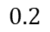
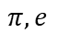
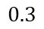
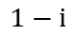
Complex ℂ
Reals ℝ
ℚ
Rationals
$$0.3$$
$$0.2$$
Integers ℤ
{..., −2, −1, 0, 1, 2, ...}
{−2, −1, 0, 1, 2}
Irrationals
ℚ’
Naturals ℕ
{0, 1, 2, 3..}
$$π, e$$
Numbers
$$1−ⅈ$$
Imaginary
$$ⅈ$$

Slide 9

<WELCOME >
<Math functions>

Slide 10
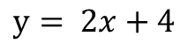
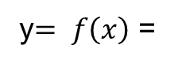
Math Functions
Math functions definition originates from equations that at most one output for any input. Usually, y is the variable that we want to find and x is the variable that we have in order to evaluate y.
$$y= 2x+4$$
1 , x = 0
x + 2 , x >0
x - 3 , x <0
f(4) = 6
f(-3) = -6
f(0) = 1
y$= f\left(x\right)$ =

Slide 11
Math Functions
x
y
1
2
3
4
f(x)
a
b
c
d
Domain
Image

Slide 12
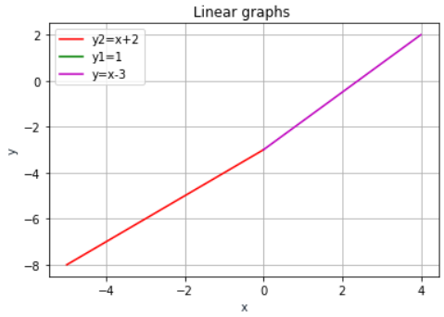
Math Functions
import matplotlib.pyplot as plt
import numpy as np
x = np.linspace(-5,0,5)
x1 = 0
x2 = np.linspace(0,4,5)
y = x-3
y1 = 1
y2 = x+2
plt.plot(x, y, '-r', label='y=x+2')
plt.plot(x1, y1, '-g', label='y=1')
plt.plot(x2, y2, '-m', label='y=x-3')
plt.title('Linear graphs ')
plt.xlabel('x’)
plt.ylabel('y’)
plt.legend(loc='upper left')
plt.grid()
plt.show()
Function f(x)
Parameter/
Parameters
Result/Results
1 , x = 0
x + 2 , x >0
x - 3 , x <0
f(4) = 6
f(-3) = -6
f(0) = 1
y = f(x) =
Linear function

Slide 13
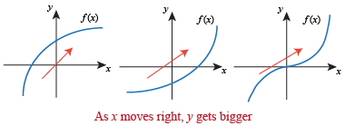
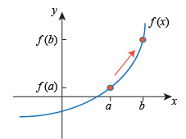
Increasing Functions
If a < b; Then f(a) < f(b)
https://www.shmoop.com/points-vectors-functions/increasing-decreasing-functions.html

Slide 14
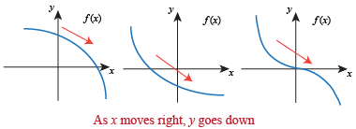
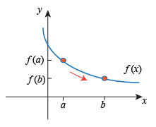
Decreasing Functions
If a > b; Then f(a) > f(b)
https://www.shmoop.com/points-vectors-functions/increasing-decreasing-functions.html

Slide 15
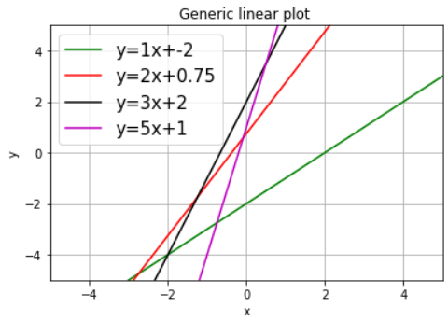
import matplotlib.pyplot as plt
import numpy as np
x = [-5,5]
m = [1,2,3,5]
b = [-2,3/4,2,1]
color = ['g', 'r', 'k', 'm']
for i in range(0,len(m)):
y = m[i]*np.array(x) + b[i]
plt.plot(x,y,label='y=%sx+%s' %(m[i],b[i]), color=color[i] )
plt.axis('auto')
plt.xlim(x)
plt.ylim(x)
plt.grid()
plt.xlabel('x')
plt.ylabel('y')
axis = plt.gca()
plt.legend(prop={'size':15})
plt.title('Generic plot.')
plt.show()
- Parallel linear functions m1 = m2
- Perpendicularity m1*m2 = -1

Slide 16
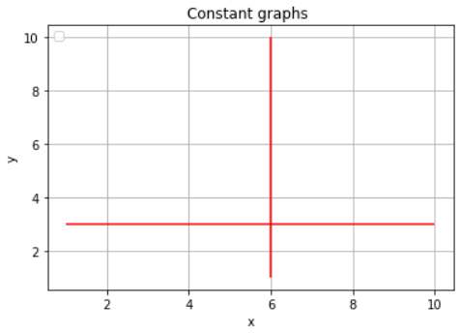
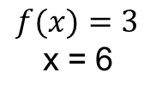
Constant Functions
$$f(x)=3$$
x = 6
import matplotlib.pyplot as plt
plt.hlines(y = 3, xmin = 1, xmax = 10, colors='r')
plt.vlines(x = 6, ymin = 1, ymax = 10, colors='r')
plt.title('Constant graphs ')
plt.xlabel('x')
plt.ylabel('y')
plt.legend(loc='upper left')
plt.grid()
plt.show()

Slide 17
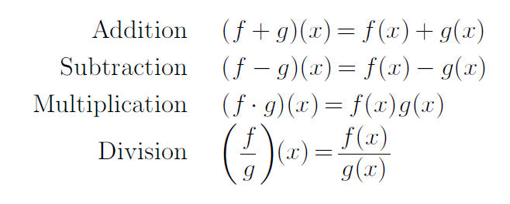
Functions Properties

Slide 18
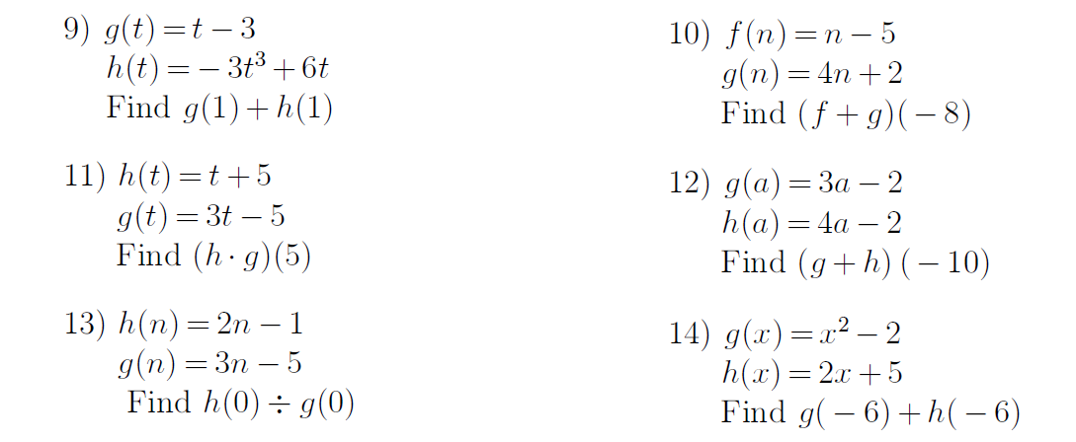
Exercises
1.
4.
2.
5.
3.
6.

Slide 19
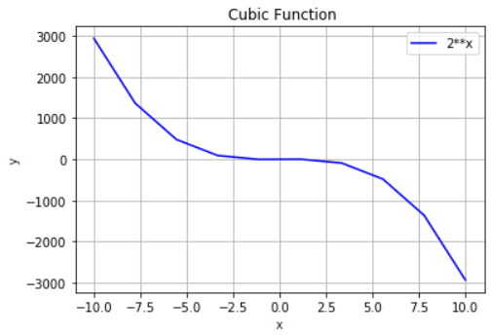
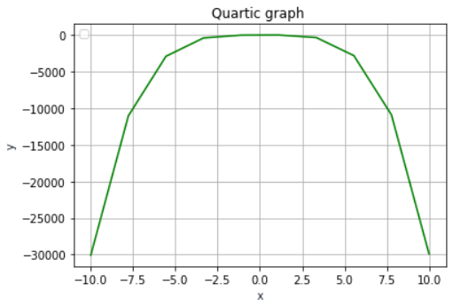
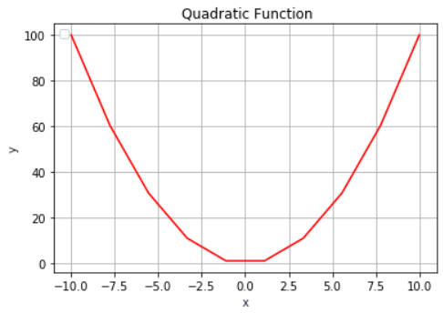
Continuous polynomial functions types
x = np.linspace(-10,10,10)
y1 = x**2
plt.plot(x, y1, '-r’)
plt.show()
x = np.linspace(-10,10,10)
y1 = -3*x**3+6*x
plt.plot(x, y1, '-b’)
plt.show()
x = np.linspace(-10,10,10)
y1 = -3*x**4+6*x+2*x
plt.plot(x, y1, '-b’)
plt.show()

Slide 20
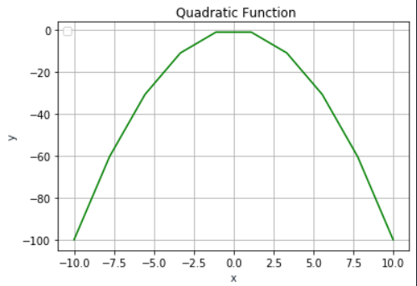
Maximum and minimum values
Inflection value (0,0)
x = np.linspace(-10,10,1))
y1 = x**2
plt.plot(x, y1, '-r’)
plt.show()
Maximum value (0,0)
Minimum value (0,0)
x = np.linspace(-10,10,10)
y1 = -3*x**3+6*x
plt.plot(x, y1, '-b')
x = np.linspace(-10,10,10)
y1 = -x**2
plt.plot(x, y1, '-g’)

Slide 21
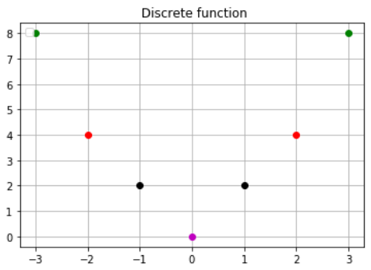
Discrete functions
import matplotlib.pyplot as plt
x = [-3,-2,-1,0,1,2,3]
y = [8,4,2,0,2,4,8]
color = ['g', 'r', 'k', 'm', 'k', 'r', 'g']
for i in range(0,len(x)):
plt.plot(x[i],y[i], 'o', color=color[i] )
plt.title(' Discrete function')
plt.legend(loc='upper left')
plt.grid()
plt.show()

Slide 22
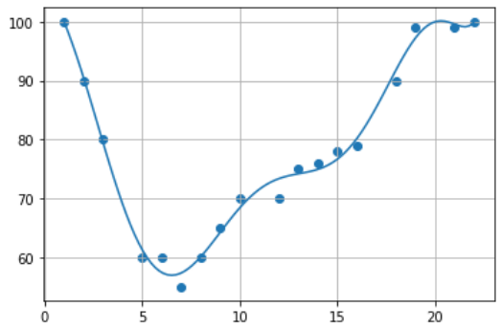
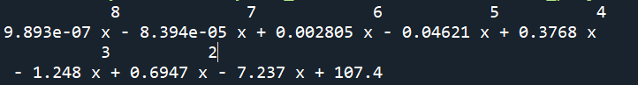
Polynomial regression
import numpy
import matplotlib.pyplot as plt
x = [1,2,3,5,6,7,8,9,10,12,13,14,15,16,18,19,21,22]
y = [100,90,80,60,60,55,60,65,70,70,75,76,78,79,90,99,99,100]
mymodel = numpy.poly1d(numpy.polyfit(x, y, 8))
myline = numpy.linspace(1, 22, 100)
plt.scatter(x, y)
plt.plot(myline, mymodel(myline))
plt.grid()
plt.show()

Slide 23
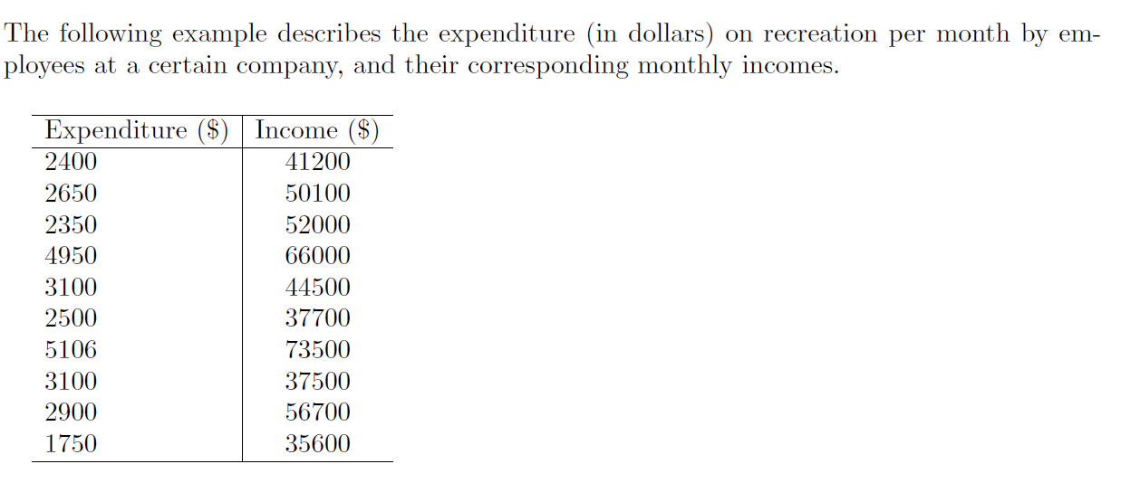
Exercises – Linear regression
What is the Slope, and the y-intercept ?
Write the linear regression equation that represents better the data in the table

Slide 24
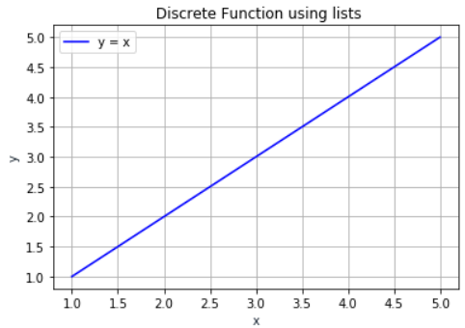
Plotting discrete functions using Lists
import matplotlib.pyplot as plt
x = [1, 2 ,3 ,4 ,5]
y1 =[1 ,2, 3, 4, 5]
plt.plot(x, y1, '-b', label= 'y = x')
plt.title(' Discrete function using lists')
plt.xlabel('x')
plt.ylabel('y')
plt.legend(loc='upper left')
plt.grid()
plt.show()

Slide 25
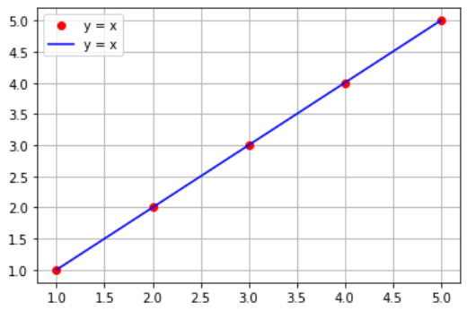
Plotting discrete functions using Tuples
import matplotlib.pyplot as plt
x =(1,2,3,4,5)
y1 = (1,2,3,4,5)
plt.plot(x,y1,'or' ,label= 'y = x')
plt.plot(x,y1,'b', label= 'y = x’)
plt.title(' Discrete function using tuples')
plt.legend(loc='upper left')
plt.grid()
plt.show()

Slide 26
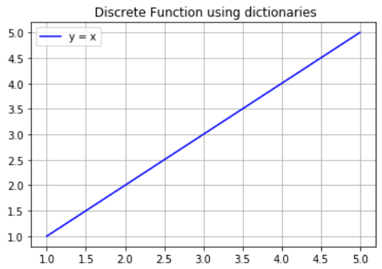
Plotting functions using Dictionaries
import matplotlib.pyplot as plt
x1 = {'x':[1,2,3,4,5], 'y1':[1,2,3,4,5] }
plt.plot('x', 'y1', '-b', label= 'y = x', data=x1)
plt.title(' Discrete function using dictionaries')
plt.legend(loc='upper left')
plt.grid()
plt.show()

Slide 27
<WELCOME >
<Exponentials>

Slide 28
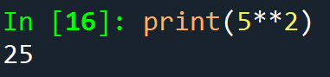
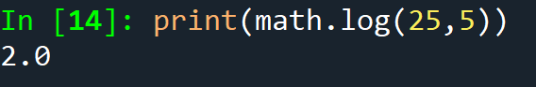
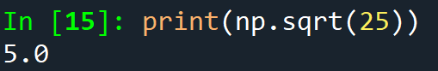
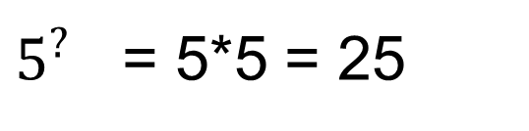
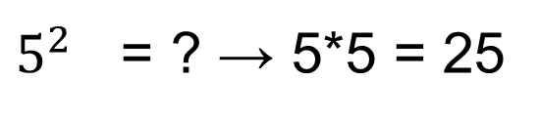
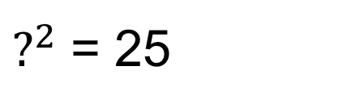


Exponentials logarithms and radicals
Exponentials
Exponent – identifies the multiplication factor.
Base – the number to be multiplied.
Exponent
$5^{2}$ = ? → 5*5 = 25
Base
Logarithms
$5^{?}$ = 5*5 = 25
$$\log_{5}{25=2 }$$
Exponent
Radicals
$?^{2}$ = 25
$$\sqrt[2]{25}=5$$
Base

Slide 29
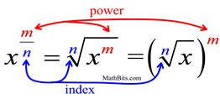
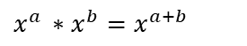
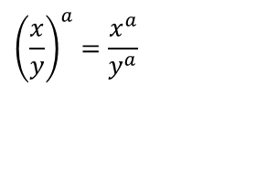
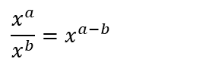
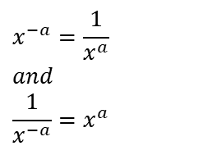
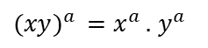
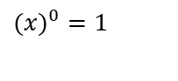
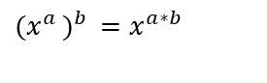
Exponentials - properties
Zero power
$$(x)^{0}=1$$
$$\frac{x^{a}}{x^{b}}=x^{a−b}$$
Quotient of powers
$$x^{−a}=\frac{1}{x^{a}} \\ and \\ \frac{1}{x^{−a}}=x^{a}$$
Negative Exponents
Product of powers
$$x^{a }∗x^{b}=x^{a+b}$$
$${\left(\frac{x}{y}\right)}^{a}=\frac{x^{a}}{y^{a}}$$
Power of a quotient
Power of a power
$${{(x}^{a })}^{b }=x^{a∗b}$$
Power of a product
$({xy)}^{a }=x^{a }.$ $y^{a }$
Rational Exponents

Slide 30
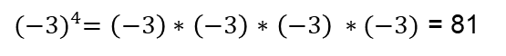
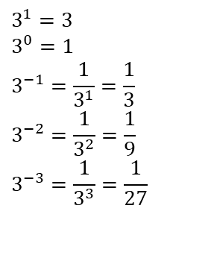
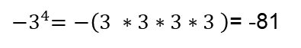
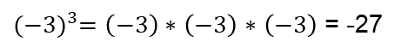
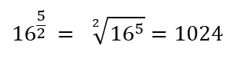
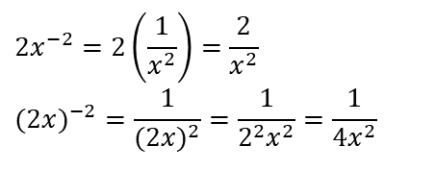
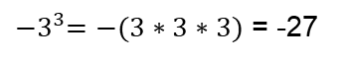
Exponentials - examples
$$3^{1}=3 \\ 3^{0}=1 \\ 3^{−1}=\frac{1}{3^{1}}=\frac{1}{3} \\ 3^{−2}=\frac{1}{3^{2}}=\frac{1}{9} \\ 3^{−3}=\frac{1}{3^{3}}=\frac{1}{27}$$
$$2x^{−2}=2\left(\frac{1}{x^{2}}\right)=\frac{2}{x^{2}} \\ (2x)^{−2}=\frac{1}{(2x)^{2}}=\frac{1}{2^{2}x^{2}}=\frac{1}{4x^{2}}$$
$${16}^{\frac{5}{2} }= \sqrt[2]{{16}^{5}}=1024$$
Be careful with the ‘-’ signal
${(−3)}^{3}=\left(−3\right)∗$ $\left(−3\right)$ $∗$ $\left(−3\right)$ = -27
${−3}^{4}=−\left(3 ∗3∗3∗3 \right)$= -81
${(−3)}^{4}=\left(−3\right)∗$ $\left(−3\right)$ $∗$ $\left(−3\right) ∗(−3)$ = 81
${−3}^{3}=−(3∗3∗3)$ = -27

Slide 31
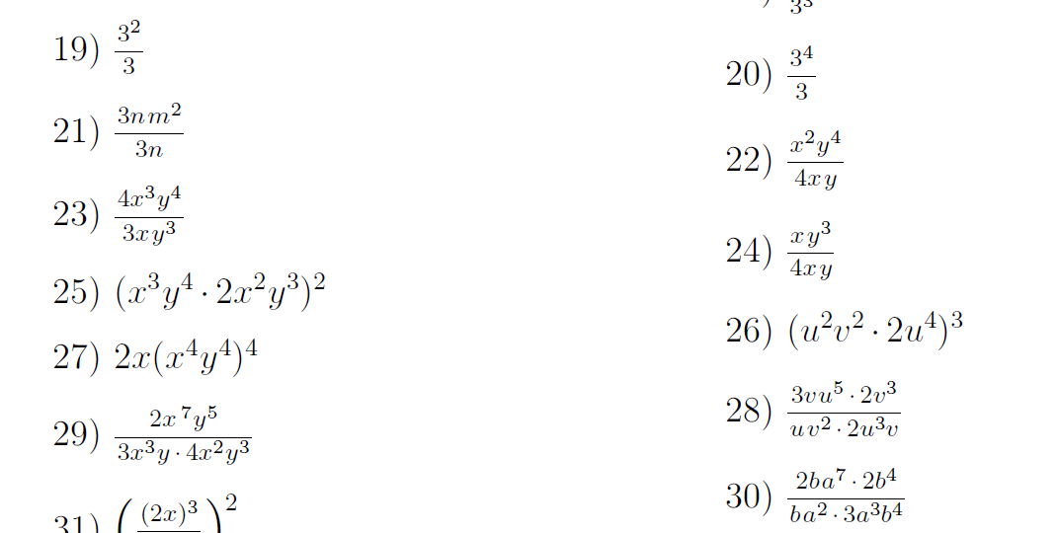
Exponentials - exercises
1.
6.
2.
7.
3.
8.
4.
9.
5.
10.

Slide 32
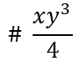






Exponentials - exercises
1.
# 3
6.
# 27
7.
$$\# \frac{xy^{3}}{4}$$
2.
$${\# m}^{2}$$
$$\# \frac{4x^{2}y}{3}$$
8.
$$\# \frac{y^{2}}{4}$$
3.
4.
$${\# 4x}^{10}y^{14}$$
9.
$${\# 8u}^{18}v^{6}$$
5.
$${\# 2x}^{17}{2y}^{16}$$
10.
# 3uv

Slide 33
<WELCOME >
<Logarithms>

Slide 34
Exponentials logarithms and radicals
Exponentials
Exponent – identifies the multiplication factor.
Base – the number to be multiplied.
Exponent
$5^{2}$ = ? → 5*5 = 25
Base
Logarithms
$5^{?}$ = 5*5 = 25
$$\log_{5}{25=2 }$$
Exponent
Radicals
$?^{2}$ = 25
$$\sqrt[2]{25}=5$$
Base

Slide 35




Logarithms properties
$$\log_{b} 1=0$$
$$\log_{b} b=1$$
Power: $\log_{b} a^{n}=n∗\log_{b} a$
Product: $\log_{b} \left(a∗c\right)=\log_{b} a+\log_{b}c$
Quotient: $\log_{b}\frac{a}{c}$ = $\log_{b} a −\log_{b}c$
Definition of Common Logarithm:
Logarithms with a base of 10 are called common logarithms. It is customary to write $\log_{10}{x} →\log{x}$
Definition of Natural Logarithm:
Logarithms with the base of $e≈2.72$ are called natural logarithms. It is customary to write $\log_{e}{x} =\ln{x}$

Slide 36

Logarithms – examples
Write each equation in its exponential form:
2 = $\log_{7}{x}$
3 = $\log_{10}{(x+8)}$
$\log_{5}{125=x}$
Rewrite into logarithms
1.
2.
3.

Slide 37




Logarithms – examples
Write each equation in its exponential form
1. 2 = $\log_{7}{x}$ ${ \#7}^{2 }=x$
2. 3 = $\log_{10}{(x+8)} \#{10}^{3 }=x+8$
${3. log}_{5}{125=x}$ # $5^{x }=$125
Rewrite into logarithms
1.
${\#log}_{2}{16=4 }$
2.
$${\#log}_{64} 8{= \frac{1}{2} }$$
3.
$${ \#log}_{e} 54.60{=4 }$$

Slide 38

Logarithms – exercises
1. ${0.6}^{\sqrt{3}}$ 2. $e^{3.2}$
3. ${(1.005)}^{400}$ 4. $\log_{4}{64}$
5. $\ln{1}$ 6.$\ln{\sqrt{7}}$
Evaluate without a calculator:
7.$\log_{5}{25}$ 8. $\log_{3}{\frac{1}{81}}$
9. $\ln{e^{−2}}$
Use the change of base formula to evaluate the logarithms:
10. $\log_{7}{3}$ 11.$\log_{2}{\frac{1}{2}}$
12.$\log_{15}{42}$
Use the properties of logarithms to rewrite each expression into lowest terms:
13. $\log{10x}$ 14. $\ln{\frac{xy}{z}}$
15. $\log_{4}{4x^{2}}$ 16. $\log_{3}{\sqrt{x−2}}$
17. $\ln{\frac{\sqrt{3x}}{7}}$

Slide 39

Logarithms – exercises
1. ${0.6}^{\sqrt{3}}$ # 0.413 2. $e^{3.2}$ # 24.533
3. ${(1.005)}^{400}$ # 7.352 4. $\log_{4}{64}$ # 3
5. $\ln{1}$ # 0 6.$\ln{\sqrt{7}}$ # 0.973
Evaluate without a calculator:
7.$\log_{5}{25}$ # 2 8. $\log_{3}{\frac{1}{81}}$ # -4
9. $\ln{e^{−2}}$ # -2
Use the change of base formula to evaluate the logarithms:
10. $\log_{7}{3}$ # 0.565 11.$\log_{2}{\frac{1}{2}}$ # -1
12.$\log_{15}{42}$ # 1.380
Use the properties of logarithms to rewrite each expression into lowest terms:
13. $\log{10x}$ # 1 + $\log{x}$ 14. $\ln{\frac{xy}{z}}$ # $\ln{x}+\ln{y}−\ln{z}$
15. $\log_{4}{4x^{2}}$ # $1+2\log_{4}{x}$ 16. $\log_{3}{\sqrt{x−2}}$ # $\frac{1}{2}\log_{3}{(x−2)}$
17. $\ln{\frac{\sqrt{3x}}{7}}$ # $\frac{1}{2}\log{3x}−\log{7}$

Slide 40
Exponentials logarithms and radicals
Exponentials
Exponent – identifies the multiplication factor.
Base – the number to be multiplied.
Exponent
$5^{2}$ = ? → 5*5 = 25
Base
Logarithms
$5^{?}$ = 5*5 = 25
$$\log_{5}{25=2 }$$
Exponent
Radicals
$?^{2}$ = 25
$$\sqrt[2]{25}=5$$
Base

Slide 41

Radicals properties
If n is a positive integer greater than 1 and both a and b are positive real numbers then,
$$\sqrt[n]{a^{n} }=a$$
$\sqrt[n]{ab }=$ $\sqrt[n]{a }$ $\sqrt[n]{b }$
$$\sqrt[n]{\frac{a}{b}} = \frac{\sqrt[n]{a}}{\sqrt[n]{b}}$$
$\sqrt[n]{a+b }$ ≠ $\sqrt[n]{a }$ + $\sqrt[n]{b }$

Slide 42


Radicals – examples
1. $\sqrt{75}$
$$\sqrt{25∗3}$$
$$\sqrt{25}∗\sqrt{3}$$
5$\sqrt{3}$
2. $\sqrt{72}$
$$\sqrt{9∗8}$$
$$\sqrt{9}∗\sqrt{8}$$
$3\sqrt{8}$
$$3\sqrt{4 ∗2}$$
$$3\sqrt{4}∗\sqrt{2}$$
$$3∗2∗\sqrt{2}$$
$$6\sqrt{2}$$

Slide 43

Radicals – exercises
1. $3\sqrt{12}$ 2. $6\sqrt{128}$
3. $7\sqrt{128}$ 4. $−8\sqrt{392}$
5. $−7\sqrt{63}$ 6.$\sqrt{192n}$
7. $\sqrt{343b}$ 8. $\sqrt{196v^{2}}$
9. $\sqrt{100n^{3}}$ 10. $\sqrt{200a^{3}}$

Slide 44

Radicals – exercises
1. $3\sqrt{12}$ # $6\sqrt{3}$ 2. $6\sqrt{128}$ # $48\sqrt{2}$
3. $7\sqrt{128}$ # $56\sqrt{2}$ 4. $−8\sqrt{392}$ # $−112\sqrt{2}$
5. $−7\sqrt{63}$ # $−21\sqrt{7}$ 6.$\sqrt{192n}$ # $8\sqrt{3n}$
7. $\sqrt{343b}$ # $7\sqrt{7b}$ 8. $\sqrt{196v^{2}}$ # $14$v
9. $\sqrt{100n^{3}}$ # $10n\sqrt{n}$ 10. $\sqrt{200a^{3}}$ # $10a\sqrt{2a}$

Slide 45



Exponents, logarithms and radicals
x = np.linspace(0,8,10)
y1 = 2**x -3
plt.plot(x, y1, ‘-m’)
plt.show()
x = np.linspace(0,100,10)
y1 = np.sqrt(x)
plt.plot(x, y1,'-m', label='y=sqrt(x)')
plt.show()
x = np.linspace(0,100,10)
y1 = np.log(x)
plt.plot(x, y1,'-m', label='y=log(x)’)
plt.show()

Slide 46

import matplotlib.pyplot as plt
import numpy as np
x = np.linspace(0,3,10)
y1 = 2**x
y2 = 3**x
y3 = (2**x) +4
y4 = (2**(x-1))
plt.plot(x,y1, 'm', label= '2**x')
plt.plot(x, y2, '-b', label= '3**x')
plt.plot(x, y3, '-r', label= '(2**x) +4')
plt.plot(x, y4, label= '(2**(x-1))')
plt.title(‘ Exponential function')
plt.xlabel('x')
plt.ylabel('y')
plt.legend(loc='upper left')
plt.grid()
plt.show()
Multiple functions for comparisons

Slide 47

import numpy as np
import matplotlib.pyplot as plt
x = np.linspace(0,4,5)
y1 = np.sqrt(x)
y2 = np.log(x)
y3 = 2**x
plt.plot(x, y1,'-m', label='y=sqrt(x)')
plt.plot(x, y2, '-b', label= 'y=log(x)')
plt.plot(x, y3, '-r', label= '(2**x)')
plt.title('Comparison graph (exp, rad and log)')
plt.xlabel('x')
plt.ylabel('y')
plt.legend(loc='upper left')
plt.grid()
plt.show()
Multiple functions comparisons

Slide 48
Make it work
Make it Right
Make it Fast

Slide 49


